Slide 1
PHYS 304: Lecture 4 (Intro to) Quantum Mechanics
Sept-Dec 2021 Edition
Jeff Young
brimacombe Rm 278, young@phas.ubc.ca

Slide 2
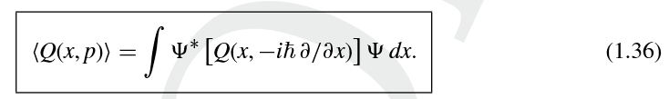
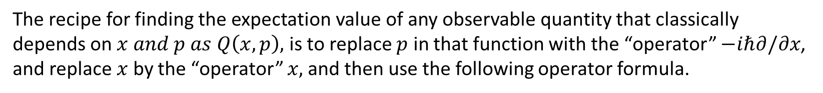
Review of Key points from last day
Everything is a particle and a wave, where the particle-like behaviour is manifest when many purely harmonic waves with different wavelengths happen to add up to yield a more-or-less localized wavepacket (the particle).
The recipe for finding the expectation value of any observable quantity that classically depends on $x and p as Q\left(x,p\right),$ is to replace $p$ in that function with the “operator” $−iℏ∂/∂x$, and replace $x$ by the “operator” $x,$and then use the following operator formula.
Notes:
Ask them if they have any questions about the first statement. Depending on response, ask what do we mean by “localization” of wavelengths?
2)Emphasize that the operator has to appear AFTER the psi* and BEFORE the \psi

Slide 3
Today
Proceed to solve the Schrödinger equation.

Slide 4

Chapter 2: Time-independent Schrödinger Equation
Lecture 4, Activity #1: [TPS, 5 mins]
The Schrödinger equation
What is the time-independent Schrödinger equation?
What is the space-independent Schrödinger equation?
How are these two equations related?

Slide 5


Chapter 2: Time-independent Schrödinger Equation
Lecture 4, Activity #1: [Share thoughts]
The Schrödinger equation
What is the time-independent Schrödinger equation?
What is the space-independent Schrödinger equation?
Notes:
From pre-reading, what is the technique used to go about simplifying the solution to this 2nd order partial differential equation? (postulating a solution that is a product of time and space independent functions, then deriving two partial differential equatons that are simpler to solve, and intimately connected to one another.
What are the arguments of psi, V and E?
What are the arguments of phi, and E?

Slide 6

Chapter 2: Time-independent Schrödinger Equation
3. How are these two equations related?
See derivation
Notes:
…and we call the constant that these two must be equal to, E, hence the time and space independent equations

Slide 7
How is this arrived at?
Notes:
Derive 2.1 from SE for them by hand, rest can just be read out.
Emphasize if they don’t follow 2.4 from 2.3 step, they should do some serious review of their calculus.

Slide 8
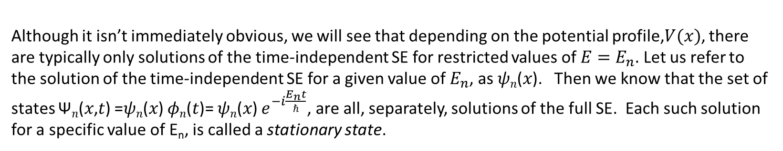
Solutions (stationary states)
Lecture 4, Activity #2: [Poll Questions]
Are there any restrictions on the solutions of the space-independent SE? (i.e. can it be solved for any value of $E$?)
for any real E. Imaginary E values would lead to un-normalizable wavefunctions
Are there any restrictions on the solutions of the time-independent SE? (i.e. can it be solved for any real value of $E$?)
Although it isn’t immediately obvious, we will see that depending on the potential profile,$V(x)$, there are typically only solutions of the time-independent SE for restricted values of $E=E_{n}.$ Let us refer to the solution of the time-independent SE for a given value of $E_{n}$, as 𝜓_{𝑛}(𝑥). Then we know that the set of states Ψ_{𝑛}(𝑥,𝑡) =𝜓_{𝑛}(𝑥) 𝜙_{𝑛}(𝑡)= 𝜓_{𝑛}(𝑥) $e^{−i\frac{E_{n}t}{ℏ}}$, are all, separately, solutions of the full SE. Each such solution for a specific value of E_{n}, is called a stationary state.
Notes:
Answer questions on Canvas, Lecture4, Activity 2: Unmarked in-class quizzlet
4. no, the solution is very simple for any value of E (to within a multiplicative constant). This is part of the motivation for assuming separable function solutions.
5. Not immediately obvious, but …

Slide 9

Stationary States
Lecture 4, Activity #3: [TPS, 5 mins]
Why is Ψ_{𝑛}(𝑥,𝑡)=𝜓_{𝑛}(𝑥) 𝜙_{𝑛}(𝑡) , corresponding to a specific value of E_{n}, called a stationary state?
Hint: find the expectation value of any operator in an arbitrary stationary state.

Slide 10
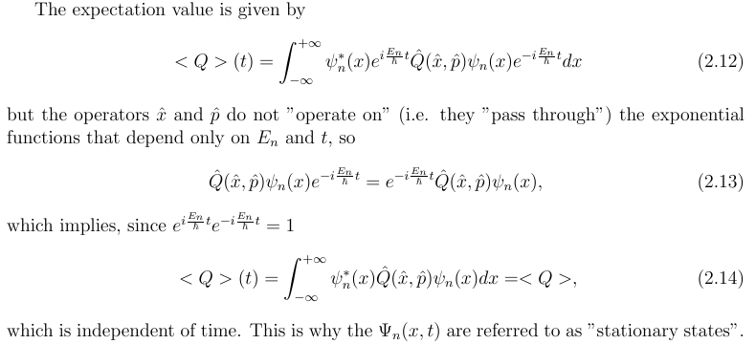
Stationary States

Slide 11
Stationary States (con’t)
Lecture 4, Activity #4: [TPS, 5 mins]
7. Derive the expectation value of the energy when the particle is in a stationary state corresponding to a value E_{n}.
Notes:
See notes

Slide 12
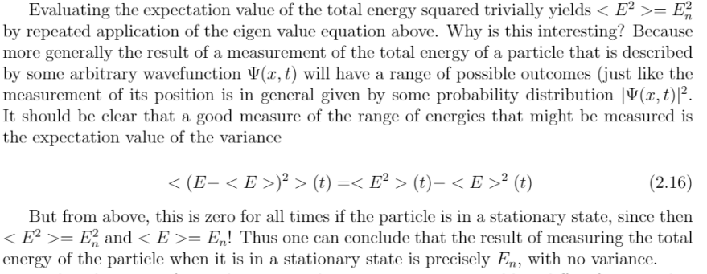
Stationary States (con’t)
Lecture 4, Activity #5: [TPS, 5 mins]
8. Derive the expectation value of the energy squared when the particle is in a stationary state corresponding to a value E_{n}. What does this tell you about the variance of the measured energy?
Notes:
See notes

Slide 13
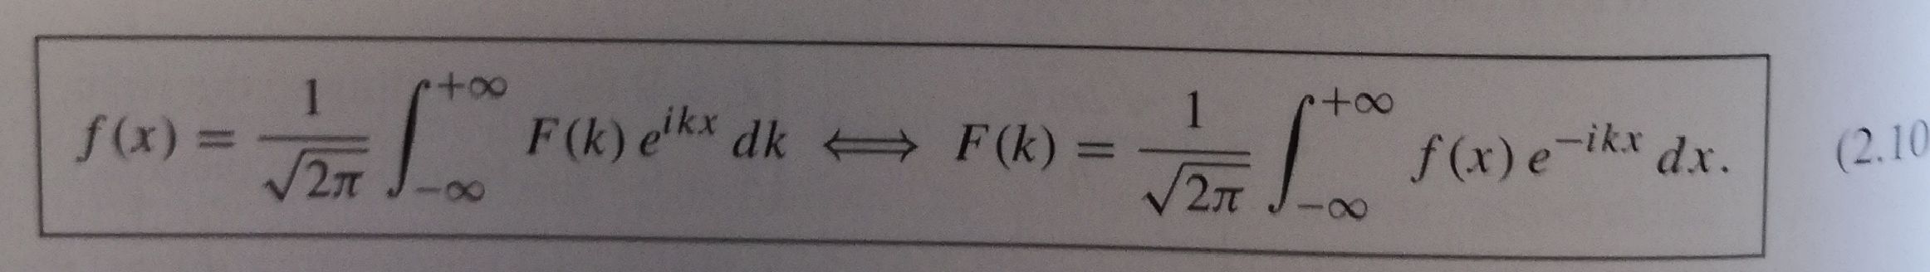

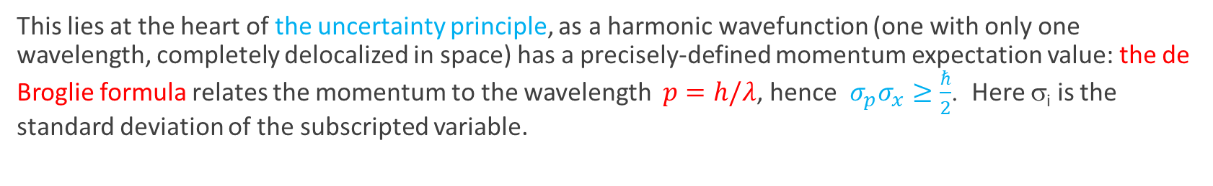
A quick note on the de Broglie wavelength (relevant to Q 1.18 in problem set)
From working with the Fourier.jar app from last time, it is clear that there is an inverse relationship between the localization of the wavefunction in position, and the “localization” in the corresponding wavelengths. This can be quantified better using $1/λ$ rather than $λ$to characterize the waves that contribute to a given wavefunction, since mathematically, the Fourier transform of a position dependent function, f(x), F(k), is defined in terms of k=2π/λ, not λ.
From Fourier analysis: ${σ_{\frac{2π}{λ}}σ}_{x}≥\frac{1}{2} or {σ_{k}σ}_{x}≥\frac{1}{2}$, and the equality only holds for Gaussian functions.
This lies at the heart of the uncertainty principle, as a harmonic wavefunction (one with only one wavelength, completely delocalized in space) has a precisely-defined momentum expectation value: the de Broglie formula relates the momentum to the wavelength $p=h/λ$, hence ${σ_{p}σ}_{x}≥\frac{ℏ}{2}$. Here σ_{i} is the standard deviation of the subscripted variable.
Notes:
Show the .jar demo again, and get them to recognize qualitatively this inverse relationship. Whether all in-phase or random, the “characteristic length” is inversely proportional to the variance in k.

Slide 14
Reminders
Tomorrow’s tutorial 3:00.
Tomorrow’s Tutorial exercises will be posted tonight.
Problem Set due Thursday morning, 9:30 AM.

